Slide 1


NETWORK FUNCTION VIRTUALIZATION (NFV) AND THE OSI ARCHITECTURE
GUIDED BY
Dr. P. JESU JAYARIN
PRESENTED BY
SACHIN.S (192525045)

Slide 2
What is NFV?
Network Function Virtualization (NFV) is a networking technology.
It replaces dedicated hardware devices with software-based network functions.
Functions like routers, firewalls, load balancers, and gateways run on virtual machines or cloud servers.
NFV reduces hardware costs and improves flexibility.
It is widely used in modern data centers and 5G networks.
OSI:
The OSI (Open Systems Interconnection) model is a standard framework that explains how data is transmitted between devices through seven communication layers.
It helps network devices from different manufacturers communicate efficiently by defining the functions of each layer.

Slide 3
OSI Layer | Role in NFV
Application | Network management applications
Presentation | Data formatting and encryption
Session | Maintains communication sessions
Transport | Reliable data delivery (TCP/UDP)
Network | Virtual routers and IP routing
Data Link | Virtual switches and MAC communication
Physical | Servers, storage, and physical network hardware

Slide 4
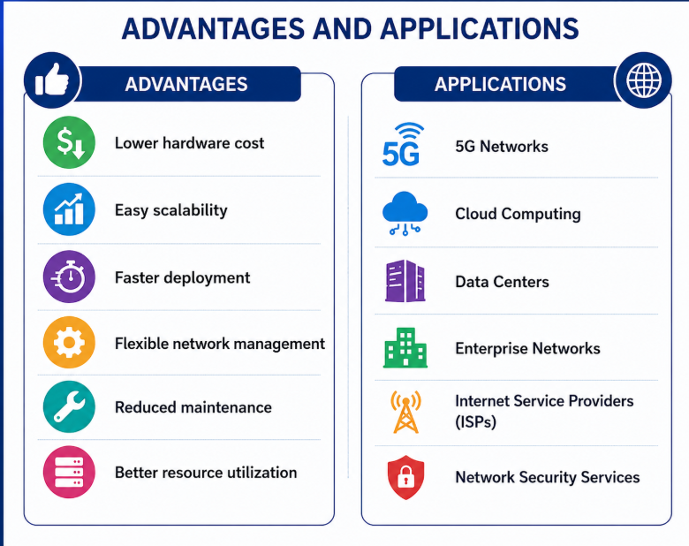
ADVANTAGES AND APPLICATIONS
Advantages
Lower hardware cost
Easy scalability
Faster deployment
Flexible network management
Reduce maintenance
Better resource utilization
Applications
5G Networks
Cloud Computing
Data Centers
Enterprise Networks
Internet Service Providers (ISPs)
Network Security Services

Slide 5
CONCLUSION
NFV transforms traditional hardware-based networking into software-based services.
It works together with the OSI Architecture to provide efficient communication.
NFV improves flexibility, scalability, and performance while reducing operational costs.
It is an essential technology for cloud computing, virtualization, and future communication networks.

Slide 6
THANKYOU

